Slide 1
Security of BIOS/UEFI System Firmware from Attacker and Defender Perspectives Section 4. Common Attack Vectors against System Firmware
Yuriy Bulygin *
Alex Bazhaniuk *
Andrew Furtak *
John Loucaides **
* Advanced Threat Research, McAfee
** Intel

Slide 2
License
Training materials are shared under Creative Commons “Attribution” license CC BY 4.0
Provide the following attribution:
Derived from “Security of BIOS/UEFI System Firmware from Attacker and Defender Perspective” training by Yuriy Bulygin, Alex Bazhaniuk, Andrew Furtak and John Loucaides available at https://github.com/advanced-threat-research/firmware-security-training

Slide 3
Section 4. Common Attack Vectors Against BIOS and UEFI Firmware

Slide 4
So What is System Firmware?
Runtime
System
Firmware
(UEFI RT,
SMM)
Operating System
App
App
Kernel + Drivers
Privilege
System Firmware
(BIOS, UEFI firmware, Coreboot…)
Hardware
Memory
CPU
Graphics
I/O
Network

Slide 5
How Can System Firmware Be Attacked?
Inadequate hardware write protections of firmware “ROM”
Firmware update implementation
Persistent Configuration (UEFI Variables, CMOS settings)
Inadequate hardware protections of runtime firmware (System Management Interrupt Handlers)
Runtime firmware (SMI handlers)
Resume from sleep states
Network stack implementation in firmware
Other interfaces with OS/software, network, devices…

Slide 6
Do BIOS Attacks Require Kernel Privileges?
Malicious App
A matter of finding legitimate signed kernel driver which can be used on behalf of user-mode exploit as a confused deputy.
RWEverything driver signed for Windows 64bit versions (co-discovered with researchers from MITRE)
OS Driver
OS Kernel
UEFI OS Loaders
UEFI DXE Core / Dispatcher
System Firmware (SEC/PEI)
Hardware
I/O
Memory
Network
Graphics

Slide 7
4.1 Attacking UEFI Secure Boot

Slide 8
4.1 (1) Attacking Secure Boot via Corruption of Firmware Root Signing Certificate (Platform Key)

Slide 9
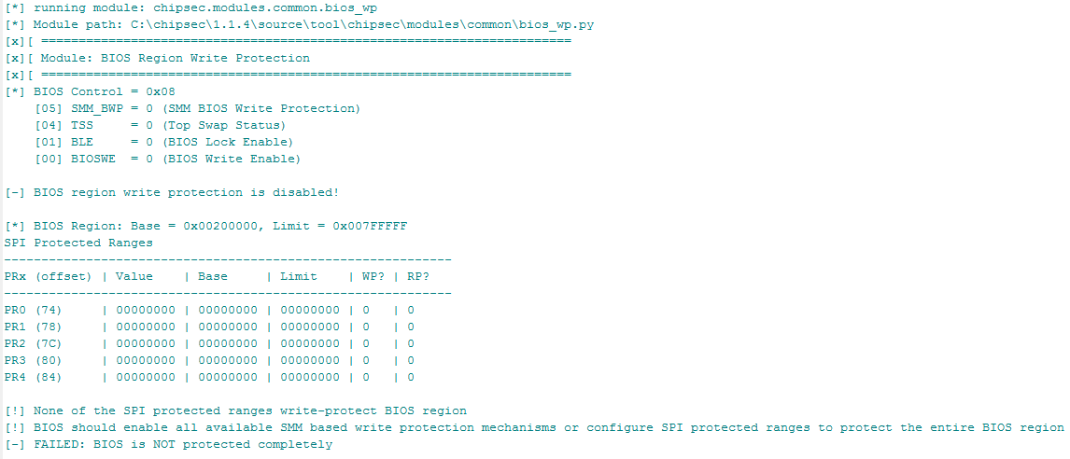
HW protection of FW in ROM
# chipsec_main.py --module common.bios_wp

Slide 10
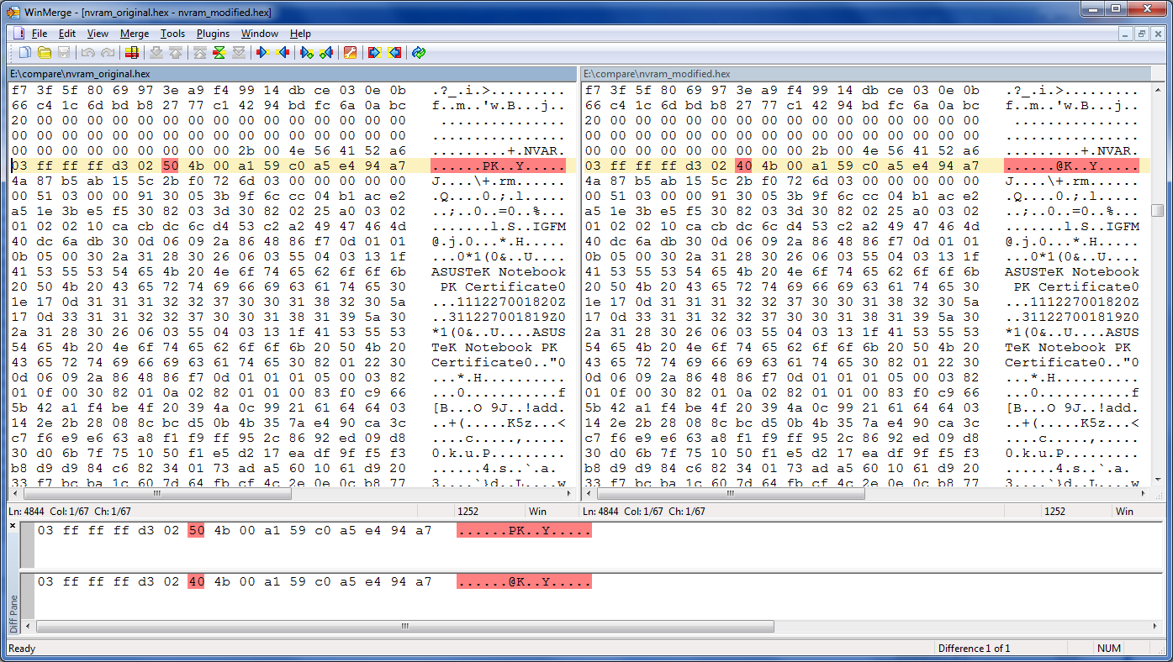
Platform Key certificate is stored in the NVRAM potion of SPI flash memory

Slide 11
Modify PK in SPI if Writes are Allowed
OS Driver
OS Exploit
Signed BIOS
Update
OS Kernel
UEFI OS Loaders
DXE
Driver
UEFI
Boot Loader
Bootx64.efi
Bootmgfw.efi
Modify UEFI BIOS Firmware in ROM
DXE
Driver
UEFI DXE Core / Dispatcher
System Firmware (SEC/PEI)
Hardware
I/O
Memory
Network
Graphics

Slide 12
Modifying Platform Key in NVRAM
Corrupt Platform Key EFI variable in NVRAM
Name (“PK”) or Vendor GUID {8BE4DF61-93CA-11D2-AA0D-00E098032B8C}
AuthenticatedVariableService DXE driver enters Secure Boot SETUP_MODE when correct “PK” EFI variable cannot be located in EFI NVRAM
Main volatile SecureBoot variable is then set to DISABLE
DXE ImageVerificationLib then assumes Secure Boot is off and skips Secure Boot checks
Generic exploit, independent of the platform/vendor
1 bit modification!

Slide 13
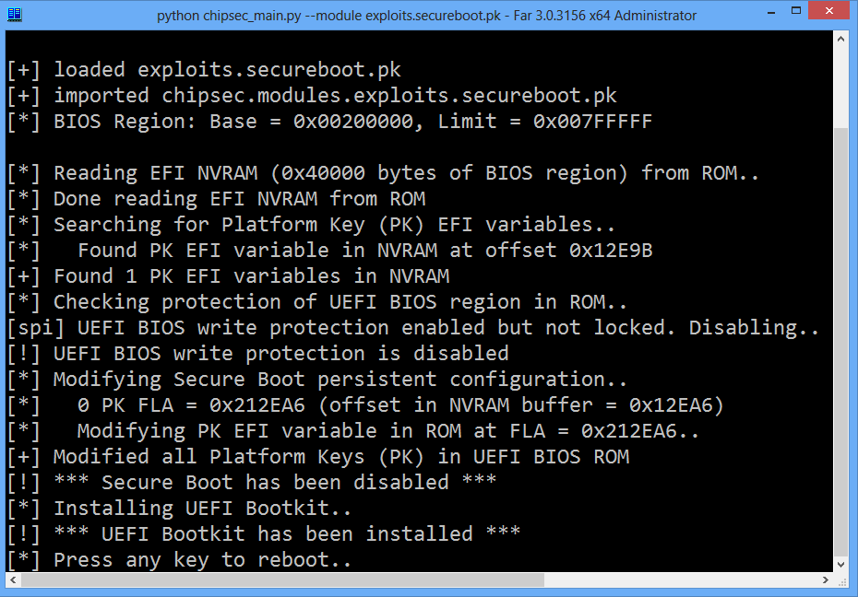

Slide 14
4.1 (2) Attacking Secure Boot via Setup UEFI Variable (On/Off, Verification Policies, CSM Enabled, “Clear Keys” control)

Slide 15
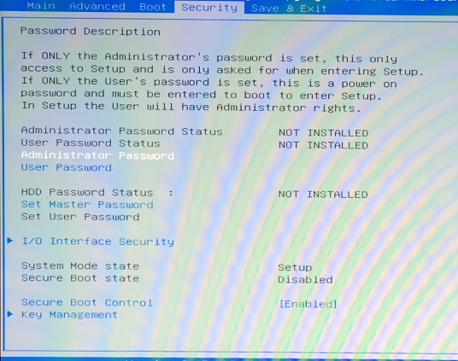
Secure Boot Can Be Turned On/Off in BIOS Setup Options

Slide 16
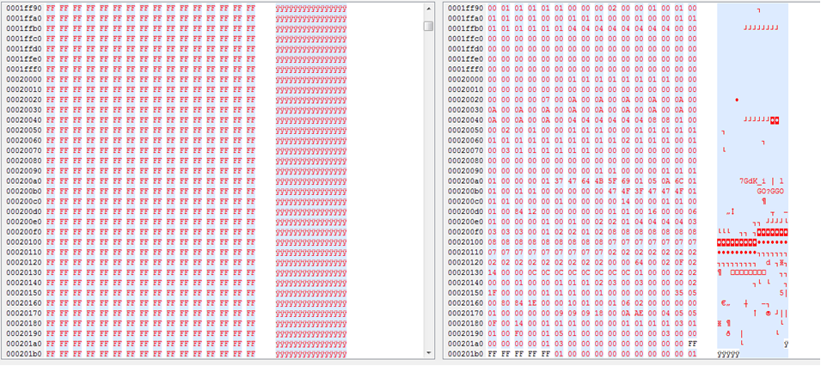
Looking for Enable Policy in SPI Dump…
chipsec_util.py spi dump spi.bin

Slide 17
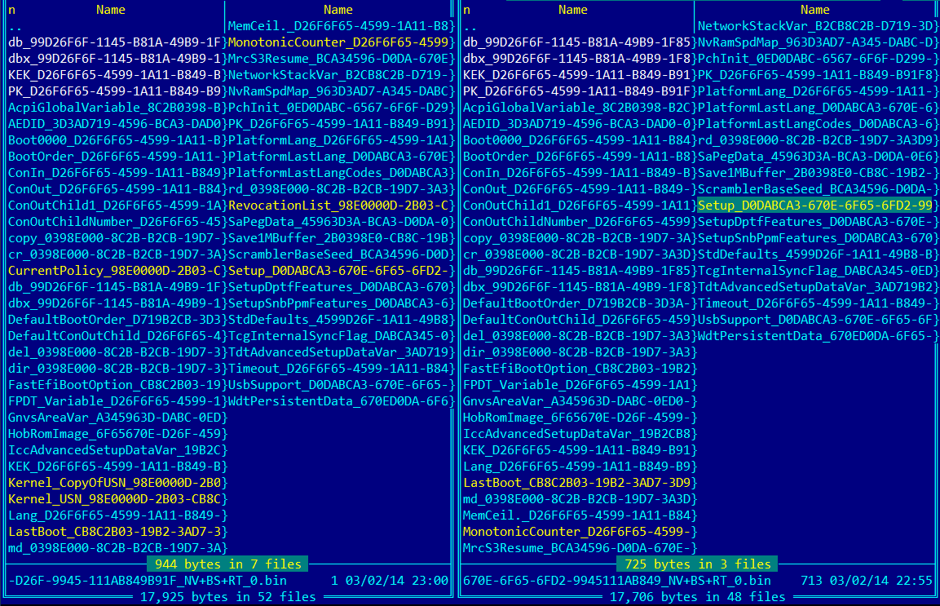
Extracting Runtime UEFI Variables…
Secure Boot On Secure Boot Off

Slide 18
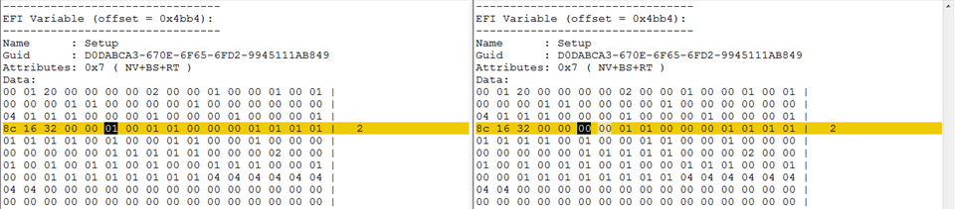
Secure Boot On/Off is Stored in “Setup”
Secure Boot On Secure Boot Off

Slide 19
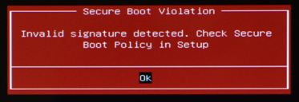
Verification Policies are Stored in “Setup”
Read ‘Setup’ UEFI variable and look for sequences
04 04 04, 00 04 04, 05 05 05, 00 05 05
We looked near Secure Boot On/Off Byte!
Modify bytes corresponding to policies to 00 (ALWAYS_EXECUTE) then write modified ‘Setup’ variable

Slide 20
Patching Image Verification Policies…
[CHIPSEC] Reading EFI variable Name='Setup' GUID={EC87D643-EBA4-4BB5-A1E5-3F3E36B20DA9} from 'Setup_orig.bin' via Variable API..
EFI variable:
Name : Setup
GUID : EC87D643-EBA4-4BB5-A1E5-3F3E36B20DA9
Data :
..
01 01 01 00 00 00 00 01 01 01 00 00 00 00 00 00 |
00 00 00 00 00 00 01 01 00 00 00 04 04 |
[CHIPSEC] (uefi) time elapsed 0.000
[CHIPSEC] Writing EFI variable Name='Setup' GUID={EC87D643-EBA4-4BB5-A1E5-3F3E36B20DA9} from 'Setup_policy_exploit.bin' via Variable API..
Writing EFI variable:
Name : Setup
GUID : EC87D643-EBA4-4BB5-A1E5-3F3E36B20DA9
Data :
..
01 01 01 00 00 00 00 01 01 01 00 00 00 00 00 00 |
00 00 00 00 00 00 01 01 00 00 04 00 00 |
[CHIPSEC] (uefi) time elapsed 0.203
OptionRomPolicy
FixedMediaPolicy
RemovableMediaPolicy

Slide 21
CSM Enabled With Secure Boot
CSM allows legacy OS to boot on top of UEFI firmware without any Secure Boot checks
Some systems have CSM enabled by default with Secure Boot enabled and fallback to boot from MBR when UEFI signature verification fails
Mitigations: Never load CSM when Secure Boot is enabled

Slide 22
Other Critical Secure Boot Config Stored in Unprotected Setup UEFI Variable
CSM Enable policy: allows malware to enable CSM with Secure Boot and boot from MBR
“Clear Secure Boot Keys” control: allows malware to clear all keys including PK thus disabling Secure Boot
“Restore Default Secure Boot Keys” control: allows malware to revert all keys and blacklist to potentially insecure “default” values
Mitigations: UEFI firmware must never store setting critical for Secure Boot in unprotected UEFI variables (such as Setup)

Slide 23
4.1 (3) Attacking Secure Boot via PE/TE Header Vulnerability

Slide 24
Does firmware allow unsigned TE executables?
SecureBoot EFI variable doesn’t exist or equals to SECURE_BOOT_MODE_DISABLE? EFI_SUCCESS
File is not valid PE/COFF image? EFI_ACCESS_DENIED
SecureBootEnable NV EFI variable doesn’t exist or equals to SECURE_BOOT_DISABLE? EFI_SUCCESS
SetupMode NV EFI variable doesn’t exist or equals to SETUP_MODE? EFI_SUCCESS

Slide 25
PE/TE Header Handling by the BIOS
Decoded UEFI BIOS image from SPI Flash

Slide 26
PE/TE Header Confusion Issue
TE format doesn’t support signatures so BIOS has to deny loading such image
In practice, BIOS implementations may differ…
ExecuteSecurityHandler calls GetFileBuffer to read an executable image
Which reads the image, checks if it has a valid PE/COFF header and returns EFI_LOAD_ERROR if not
In case of an image load error, ExecuteSecurityHandler returns EFI_SUCCESS (0)
Signature Checks are Skipped!

Slide 27
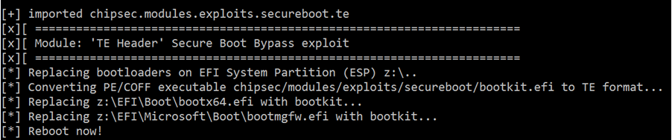
PE/TE Header Confusion Attack
Convert malicious PE/COFF EFI executable (bootkit.efi) to TE by replacing the image header
Replace OS boot loaders with resulting TE EFI executable
Vulnerable BIOS skips signature check for this executable
Malicious bootkit.efi loads & patches original OS boot loader

Slide 28
Exercise 4.1
Bypassing UEFI Secure Boot (PE/TE)

Slide 29
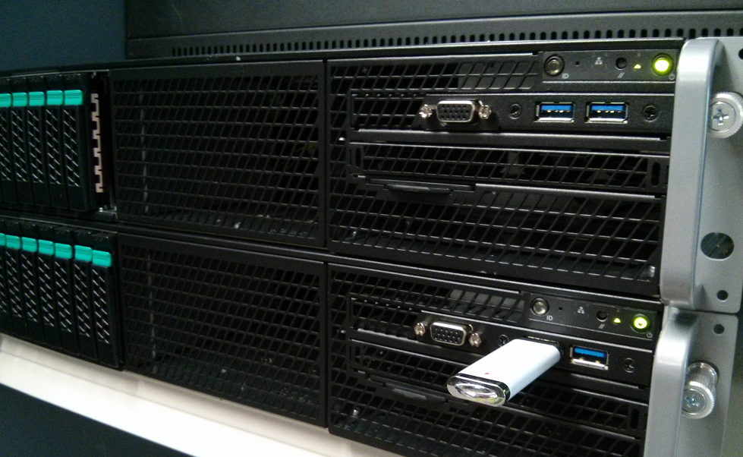
4.2 Attacking SPI Flash Protections

Slide 30
BIOS Range is Not Protected in SPI
BIOS Write Protections often still not properly enabled on many systems
SMM based write protection of entire BIOS region is often not used: BIOS_CONTROL[SMM_BWP]
If SPI Protected Ranges (mode agnostic) are used (defined by PR0-PR4 in SPI MMIO), they often don’t cover entire BIOS & NVRAM
Some platforms use SPI device specific write protection but only for boot block/startup code or SPI Flash descriptor region
Mitigations:
Set BIOS_CONTROL[SMM_BWP] ← 1
Program SPI flash protected ranges (PRx) to cover BIOS range
References: Persistent BIOS Infection (used flashrom on legacy BIOS), Evil Maid Just Got Angrier, BIOS Chronomancy, A Tale Of One Software Bypass Of Windows 8 Secure Boot

Slide 31
Checking with common.bios_wp
# chipsec_main.py --module common.bios_wp
[*] running module: chipsec.modules.common.bios_wp
[x][ =======================================================================
[x][ Module: BIOS Region Write Protection
[x][ =======================================================================
[*] BIOS Control = 0x02
[05] SMM_BWP = 0 (SMM BIOS Write Protection)
[04] TSS = 0 (Top Swap Status)
[01] BLE = 1 (BIOS Lock Enable)
[00] BIOSWE = 0 (BIOS Write Enable)
[!] Enhanced SMM BIOS region write protection has not been enabled (SMM_BWP is not used)
[*] BIOS Region: Base = 0x00500000, Limit = 0x007FFFFF
SPI Protected Ranges
------------------------------------------------------------
PRx (offset) | Value | Base | Limit | WP? | RP?
------------------------------------------------------------
PR0 (74) | 87FF0780 | 00780000 | 007FF000 | 1 | 0
PR1 (78) | 00000000 | 00000000 | 00000000 | 0 | 0
PR2 (7C) | 00000000 | 00000000 | 00000000 | 0 | 0
PR3 (80) | 00000000 | 00000000 | 00000000 | 0 | 0
PR4 (84) | 00000000 | 00000000 | 00000000 | 0 | 0
[!] SPI protected ranges write-protect parts of BIOS region (other parts of BIOS can be modified)
[!] BIOS should enable all available SMM based write protection mechanisms or configure SPI protected ranges to protect the entire BIOS region
[-] FAILED: BIOS is NOT protected completely

Slide 32
SMI Suppression Attack (If SMM Based BIOS WP is Not Used)
Some systems write-protect BIOS by disabling BIOS Write-Enable (BIOSWE) and setting BIOS Lock Enable (BLE) but don’t use SMM based write-protection BIOS_CONTROL[SMM_BWP]
SMI event is generated when Update SW writes BIOSWE=1
Possible attack against this configuration is to block SMI events
E.g. disable all chipset sources of SMI: clear SMI_EN[GBL_SMI_EN] if BIOS didn’t set GBL_SMI_LOCK: Setup for Failure: Defeating SecureBoot
Another variant is to disable specific TCO SMI source used for BIOSWE/BLE (clear TCO_EN in SMI_EN if BIOS didn’t set TCO_LCK)
Mitigations:
Set BIOS_CONTROL[SMM_BWP] ← 1 and lock SMI configuration (set GBL_SMI_LCK, TCO_LCK)

Slide 33
Checking with common.bios_smi
# chipsec_main.py --module common.bios_smi
[*] running module: chipsec.modules.common.bios_smi
[x][ =======================================================================
[x][ Module: SMI Events Configuration
[x][ =======================================================================
[-] SMM BIOS region write protection has not been enabled (SMM_BWP is not used)
[*] PMBASE (ACPI I/O Base) = 0x0400
[*] SMI_EN (SMI Control and Enable) register [I/O port 0x430] = 0x00002033
[13] TCO_EN (TCO Enable) = 1
[00] GBL_SMI_EN (Global SMI Enable) = 1
[+] All required SMI events are enabled
[*] TCOBASE (TCO I/O Base) = 0x0460
[*] TCO1_CNT (TCO1 Control) register [I/O port 0x468] = 0x1800
[12] TCO_LOCK = 1
[+] TCO SMI configuration is locked
[*] GEN_PMCON_1 (General PM Config 1) register [BDF 0:31:0 + 0xA0] = 0x0A14
[04] SMI_LOCK = 1
[+] SMI events global configuration is locked
[+] PASSED: All required SMI sources seem to be enabled and locked!

Slide 34
Unlocked SPI Flash Config. / PRx
Some BIOS rely on SPI Protected Ranges (PR0-PR4 registers in SPI MMIO) to provide write protection of regions of SPI Flash
SPI Flash Controller configuration including PRx has to be locked down by BIOS via Flash Lockdown
If BIOS doesn’t lock SPI Controller configuration (by setting FLOCKDN bit in HSFS SPI MMIO register), malware can disable SPI protected ranges re-enabling write access to SPI Flash
Mitigations:
Set HSFS[FLOCKDN] ⬅ 1

Slide 35
Checking with common.spi_lock
# chipsec_main.py --module common.spi_lock
[*] running module: chipsec.modules.common.spi_lock [x][ ======================================================= [x][ Module: SPI Flash Controller Configuration Lock [x][ ======================================================= [*] HSFSTS register = 0x0004E008 FLOCKDN = 1 [+] PASSED: SPI Flash Controller configuration is locked

Slide 36
Insecure Access Permissions in SPI Flash Descriptor
SPI flash memory is operating in descriptor mode, i.e. when valid flash descriptor is present in SPI flash
In descriptor mode, flash descriptor defines access permissions to various regions in SPI flash by different SPI bus masters, e.g. by CPU host software such as BIOS or OS
FD itself is a region and is access permission to FD allows writes from BIOS/OS after manufacturing then any code at BIOS/OS level can modify it
Master Read/Write Access to Flash Regions
--------------------------------------------------------
Region | CPU/BIOS | ME | GBe
--------------------------------------------------------
0 Flash Descriptor | R | R |
1 BIOS | RW | |
...
Access permissions to SPI flash descriptor

Slide 37
Checking with common.spi_desc
# chipsec_main.py --module common.spi_desc
[*] running module: chipsec.modules.common.spi_desc
[x][ =======================================================================
[x][ Module: SPI Flash Region Access Control
[x][ =======================================================================
[*] FRAP = 0x00004A4B << SPI Flash Regions Access Permisions Register (SPIBAR + 0x50)
[00] BRRA = 4B << BIOS Region Read Access
[08] BRWA = 4A << BIOS Region Write Access
[16] BMRAG = 0 << BIOS Master Read Access Grant
[24] BMWAG = 0 << BIOS Master Write Access Grant
[*] Software access to SPI flash regions: read = 0x4B, write = 0x4A
[+] PASSED: SPI flash permissions prevent SW from writing to flash descriptor

Slide 38
Exercise 4.2
BIOS/SPI Flash Protections

Slide 39
4.3 Attacking BIOS Update

Slide 40
Exploiting Unsigned BMP Image File
Unsigned sections within BIOS update (e.g. boot splash logo BMP image)
BIOS displayed the logo before SPI Flash write-protection was enabled
EDK ConvertBmpToGopBlt() integer overflow followed by memory corruption during DXE while parsing BMP image
Copy loop overwrote #PF handler and triggered #PF
References:
Attacking Intel BIOS

Slide 41
UEFI Exploit via .BMP Logo File
High DRAM
Page Tables
Page Fault due to access to unmapped page takes to overwritten #PF handler
GDT
BMP destination buffer overflow direction
IDT / #PF ISR
Destination buffer
BMP copy to dest buffer
BMP boot logo file
UEFI copy loop
Source: Attacking Intel BIOS by Rafal Wojtczuk & Alexander Tereshkin

Slide 42
RBU Packet Parsing Vulnerability
Legacy BIOS with signed BIOS update
OS schedules BIOS update placing new BIOS image in DRAM split into RBU packets
Upon reboot, BIOS Update SMI Handler reconstructs BIOS image from RBU packets in SMRAM and verifies signature
Buffer overflow (memcpy with controlled size/dest/src) when copying RBU packet to a buffer with reconstructed BIOS image
References:
BIOS Chronomancy: Fixing the Core Root of Trust for Measurement
Defeating Signed BIOS Enforcement

Slide 43
EDK2 Capsule BOF Vulnerabilities
Attacker sets up a capsule in memory, and when capsule update is called, BIOS parses the data provided by the attacker
Capsule Coalescing – when the blocks of a capsule are made contiguous, an integer overflow allowed attackers to control a memory copy operation.
Capsule Envelop – when blocks of the capsule are parsed, an integer overflow allowed attackers to cause a small allocation and large memory copy operation.
References:
Extreme Privilege Escalation on Windows 8/UEFI Systems

Slide 44
4.4 Attacking SMRAM

Slide 45
Unlocked Compatible/Legacy SMRAM
D_LCK bit in SMRAMC register locks down configuration of Compatible SMM range (a.k.a. CSEG)
SMRAMC[D_OPEN]=0 forces access to legacy SMM space decode to system bus rather than to DRAM where SMI handlers are when CPU is not in System Management Mode (SMM)
When D_LCK is not set by BIOS, SMM space decode can be changed to open access to CSEG if CPU is not in SMM
References:
Using CPU SMM to Circumvent OS Security Functions
Using SMM For Other Purposes

Slide 46
Compatible SMM Space: Normal Decode
SMRAMC [D_LCK] = 1
SMRAMC [D_OPEN] = 0
0xBFFFF
SMM access to CSEG is decoded to DRAM, non-SMM access is sent to system bus
Compatible SMRAM (CSEG)
Non SMM access
0xA0000
Source: Using CPU SMM to Circumvent OS Security Functions, Using SMM For Other Purposes

Slide 47
Compatible SMM Space: Unlocked
SMRAMC [D_LCK] = 0
SMRAMC [D_OPEN] = 1
0xBFFFF
Non-SMM access to CSEG is decoded to DRAM where SMI handlers can be modified
Compatible SMRAM (CSEG)
Non SMM access
0xA0000
Source: Using CPU SMM to Circumvent OS Security Functions, Using SMM For Other Purposes

Slide 48
Detecting with common.smm
# chipsec_main.py --module common.smm
[*] running module: chipsec.modules.common.smm [x][ ========================================================== [x][ Module: SMM memory (SMRAM) Lock [x][ ========================================================== [*] SMRAM register = 0x1A ( D_LCK = 1, D_OPEN = 0 ) [+] PASSED: SMRAM is locked

Slide 49
SMRAM “Cache Poisoning” Attack
CPU executes from cache if memory type is cacheable
Ring0 exploit can make SMRAM cacheable (variable MTRR)
Ring0 exploit can then populate cache-lines at SMBASE with SMI exploit code (ex. modify SMBASE) and trigger SMI
CPU upon entering SMM will execute SMI exploit from cache
Mitigations: CPU System Management Range Registers (SMRR) forcing UC and blocking access to SMRAM when CPU is not in SMM. BIOS has to enable SMRR
References:
Attacking SMM Memory via Intel Cache Poisoning
Getting Into the SMRAM: SMM Reloaded

Slide 50
Checking with common.smrr
[*] running module: chipsec.modules.common.smrr
[x][ =======================================================================
[x][ Module: CPU SMM Cache Poisoning / SMM Range Registers (SMRR)
[x][ =======================================================================
[+] OK. SMRR are supported in IA32_MTRRCAP_MSR
[*] Checking SMRR Base programming..
[*] IA32_SMRR_BASE_MSR = 0x00000000BD000006
BASE = 0xBD000000
MEMTYPE = 6
[+] SMRR Memtype is WB
[+] OK so far. SMRR Base is programmed
[*] Checking SMRR Mask programming..
[*] IA32_SMRR_MASK_MSR = 0x00000000FF800800
MASK = 0xFF800000
VLD = 1
[+] OK so far. SMRR are enabled in SMRR_MASK MSR
[*] Verifying that SMRR_BASE/MASK have the same values on all logical CPUs..
[CPU0] SMRR_BASE = 00000000BD000006, SMRR_MASK = 00000000FF800800
[CPU1] SMRR_BASE = 00000000BD000006, SMRR_MASK = 00000000FF800800
[CPU2] SMRR_BASE = 00000000BD000006, SMRR_MASK = 00000000FF800800
[CPU3] SMRR_BASE = 00000000BD000006, SMRR_MASK = 00000000FF800800
[+] OK so far. SMRR MSRs match on all CPUs
[+] PASSED: SMRR protection against cache attack seems properly configured

Slide 51
SMRAM Memory Remapping Attack
Remap Window is used to reclaim DRAM range below 4Gb “lost” for Low MMIO
Defined by REMAPBASE/REMAPLIMIT registers in Memory Controller PCIe configuration space
MC remaps Reclaim Window access to DRAM below 4GB (above Top Of Low DRAM)
If not locked, OS malware can reprogram target of reclaim to overlap with SMRAM (or something else)
Mitigations: BIOS has to lock down Memory Map registers including REMAP*, TOLUD/TOUUD
References:
Preventing & Detecting Xen Hypervisor Subversions

Slide 52
Memory Remapping: Normal Memory Map
REMAPLIMIT
Memory Reclaim/Remap Range
Access
Access is remapped to DRAM range ‘lost’ to MMIO (memory reclaimed)
REMAPBASE
4GB
Low MMIO Range
TOLUD
SMRAM
Source: Preventing & Detecting Xen Hypervisor Subversions

Slide 53
Memory Remapping: Attacking SMRAM
REMAPLIMIT
Memory Reclaim/Remap Range
Access
REMAPBASE
4GB
Target range of memory reclaim changed to SMRAM
Low MMIO Range
SMRAM
TOLUD
Source: Preventing & Detecting Xen Hypervisor Subversions

Slide 54
Checking with remap
# chipsec_main.py --module remap
[*] running module: chipsec.modules.remap
[x][ =======================================================================
[x][ Module: Memory Remapping Configuration
[x][ =======================================================================
[*] Registers:
[*] TOUUD : 0x000000011E600001
[*] REMAPLIMIT: 0x000000011E500001
[*] REMAPBASE : 0x0000000100000001
[*] TOLUD : 0xDFA00001
[*] TSEGMB : 0xDD000001
[*] Memory Map:
[*] Top Of Upper Memory: 0x000000011E600000
[*] Remap Limit Address: 0x000000011E5FFFFF
[*] Remap Base Address : 0x0000000100000000
[*] 4GB : 0x0000000100000000
[*] Top Of Low Memory : 0x00000000DFA00000
[*] TSEG (SMRAM) Base : 0x00000000DD000000
[*] checking memory remap configuration..
[*] Memory Remap is enabled
[+] Remap window configuration is correct: REMAPBASE <= REMAPLIMIT < TOUUD
[+] All addresses are 1MB aligned
[*] checking if memory remap configuration is locked..
[+] TOUUD is locked
[+] TOLUD is locked
[+] REMAPBASE and REMAPLIMIT are locked
[+] PASSED: Memory Remap is configured correctly and locked

Slide 55
SMRAM Redirection via GFx Aperture
If BIOS doesn’t lock down memory config, boundary separating DRAM and MMIO (TOLUD) can be moved somewhere else. E.g. malware can move it below SMRAM to make SMRAM decode as MMIO
Graphics Aperture can then be overlapped with SMRAM and used to redirect MMIO access to memory range defined by PTE entries in Graphics Translation Table (GTT)
When CPU accesses protected SMRAM range to execute SMI handler, access is redirected to unprotected memory range somewhere else in DRAM
Mitigations: Similarly to Remapping Attack, BIOS has to lock down HW memory configuration (i.e. TOLUD) to mitigate this attack
References: System Management Mode Design and Security Issues (GART)

Slide 56
Access in SMM: Normal Memory Map
4GB
Low MMIO Range
Access to GFx aperture (MMIO) is redirected to GFx DRAM range per GTT PTEs
GTT MMIO
Access to GFx Aperture
Graphics Aperture
GTT PTEs
TOLUD
GFx Memory
Code fetch at SMBASE in SMM
SMRAM
CPU executes instructions (mov) from SMRAM normally
mov ebx,imm32
Source: System Management Mode Design and Security Issues

Slide 57
Access in SMM: GFx Aperture Redirection
4GB
Low MMIO Range
GTT MMIO
GFx Memory
CPU executes instructions from fake SMRAM redirected to by MMIO →GFx Aperture per malicious GTT PTEs
Code fetch at SMBASE in SMM
SMRAM
Graphics Aperture
mov ebx,imm32
GTT PTEs
TOLUD
Fake SMRAM
Source: System Management Mode Design and Security Issues

Slide 58
DMA Attacks on SMRAM
Protection from inbound DMA access is guaranteed by programming TSEG range
If BIOS doesn’t lock down TSEG range configuration, malware can move TSEG outside of where actual SMRAM is
Then program one of DMA capable devices (e.g. GPU device) or Graphics Aperture to access SMRAM
Mitigations: BIOS has to lock down configuration required to define range protecting SMRAM from inbound DMA access (e.g. TSEG range)
References:
Programmed I/O accesses: a threat to Virtual Machine Monitors?
System Management Mode Design and Security Issues

Slide 59
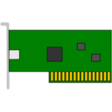
DMA Access to SMRAM
4GB
Low MMIO Range
TOLUD
GFx Mem Base
SMRAM
DMA access to SMRAM is blocked due to TSEG covering SMRAM
TSEG Base

Slide 60
DMA Access to SMRAM: DMA Attacks
4GB
Low MMIO Range
Access to GFx Aperture is redirected to SMRAM
GTT MMIO
Graphics Aperture
TOLUD
GTT PTEs
GFx Mem Base
TSEG Base
SMRAM
DMA access to SMRAM is not blocked as TSEG Base moved

Slide 61
Checking with smm_dma
# chipsec_main.py --module smm_dma
[*] running module: chipsec.modules.smm_dma
[x][ =======================================================================
[x][ Module: SMRAM DMA Protection
[x][ =======================================================================
[*] Registers:
[*] PCI0.0.0_TOLUD = 0xDFA00001 << Top of Low Usable DRAM (b:d.f 00:00.0 + 0xBC)
[*] PCI0.0.0_BGSM = 0xDD800001 << Base of GTT Stolen Memory (b:d.f 00:00.0 + 0xB4)
[*] PCI0.0.0_TSEGMB = 0xDD000001 << TSEG Memory Base (b:d.f 00:00.0 + 0xB8)
[*] IA32_SMRR_PHYSBASE = 0xDD000006 << SMRR Base Address MSR (MSR 0x1F2)
[*] IA32_SMRR_PHYSMASK = 0xFF800800 << SMRR Range Mask MSR (MSR 0x1F3)
[*] Memory Map:
[*] Top Of Low Memory : 0xDFA00000
[*] TSEG Range (TSEGMB-BGSM) : [0xDD000000-0xDD7FFFFF]
[*] SMRR Range (size = 0x00800000): [0xDD000000-0xDD7FFFFF]
[*] checking locks..
[+] TSEGMB is locked
[+] BGSM is locked
[*] checking TSEG alignment..
[+] TSEGMB is 8MB aligned
[*] checking TSEG covers entire SMRR range..
[+] TSEG covers entire SMRAM
[+] PASSED: TSEG is properly configured. SMRAM is protected from DMA attacks

Slide 62
4.5 Attacking Hardware Configuration

Slide 63
BIOS Top Boot-Block Swap Attack
Top Swap Mode allows fault-tolerant update of the BIOS boot-block
Enabled by BUC[TS] in Root Complex MMIO range
Chipset inverts A16 line (A16-A20 depending on the size of boot-block) of the address targeting ROM, e.g. when CPU fetches reset vector on reboot
Thus CPU executes from 0xFFFEFFF0 inside “backup” boot-block rather than from 0xFFFFFFF0
Top Swap indicator is not reset on reboot (requires RTC reset)
When not locked/protected, malware can redirect execution of reset vector to alternate (backup) boot-block
Mitigations: BIOS has to lock down Top Swap configuration (BIOS Interface Lock in General Control & Status register) & protect swap boot-block range in SPI
References: BIOS Boot Hijacking and VMware Vulnerabilities Digging

Slide 64
BIOS Top Boot-Block Swap Attack
CPU normally fetches reset vector at FFFFFFF0h
0xFFFFFFF0
Original BIOS Boot-Block
0xFFFEFFF0
When TS is not locked:
Malware sets BUC[TS]
Out of reset, CPU starts at reset vector
Chipset inverts A16
CPU fetches instr. from alternate BB (at FFFEFFF0h) instead of FFFFFFF0h
Alternate BIOS Boot-Block
(BUC[TS] = 1)
Source: BIOS Boot Hijacking and VMware Vulnerabilities Digging

Slide 65
Checking with common.bios_ts
# chipsec_main.py --module common.bios_ts
[*] running module: chipsec.modules.common.bios_ts
[x][ =======================================================================
[x][ Module: BIOS Interface Lock and Top Swap Mode
[x][ =======================================================================
[*] BC = 0x2A << BIOS Control (b:d.f 00:31.0 + 0xDC)
[00] BIOSWE = 0 << BIOS Write Enable
[01] BLE = 1 << BIOS Lock Enable
[02] SRC = 2 << SPI Read Configuration
[04] TSS = 0 << Top Swap Status
[05] SMM_BWP = 1 << SMM BIOS Write Protection
[*] BIOS Top Swap mode is disabled
[*] BUC = 0x00000000 << Backed Up Control (RCBA + 0x3414)
[00] TS = 0 << Top Swap
[*] RTC version of TS = 0
[*] GCS = 0x00000021 << General Control and Status (RCBA + 0x3410)
[00] BILD = 1 << BIOS Interface Lock Down
[10] BBS = 0
[+] PASSED: BIOS Interface is locked (including Top Swap Mode)

Slide 66
4.6 (1) Attacking SMI Handlers: SMI Call-Outs

Slide 67
SMI Call-Out Vulnerabilities
OS level exploit stores payload in F-segment below 1MB (0xF8070 physical address)
Exploit has to also reprogram PAM to write to F-segment
Then triggers SW SMI via APMC port (I/O 0xB2)
SMI handler does CALL 0F000:08070 in SMM
References:
In 2009, SMI call-out vulnerabilities were discovered by Rafal Wojtczuk and Alex Tereshkin in EFI SMI handlers (Attacking Intel BIOS) and by Filip Wecherowski in legacy SMI (BIOS SMM Privilege Escalation Vulnerabilities)
Also discussed by Loic Duflot in System Management Mode Design and Security Issues
In 2015, researchers from LegbaCore found that many modern systems are still vulnerable to these issues How Many Million BIOS Would You Like To Infect (paper)

Slide 68
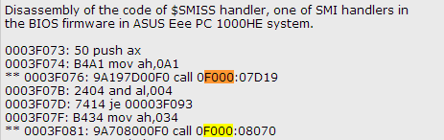
Legacy SMI Call-Out Vulnerabilities
14 call-out vulnerabilities in one SMI handler!
BIOS SMM Privilege Escalation Vulnerabilities

Slide 69
Legacy SMI Handlers Calling Out of SMRAM
Phys Memory
SMRAM
CALL F000:8070
Legacy BIOS Shadow
(F/ E-segments)
PA = 0xF0000
1 MB

Slide 70
SMI Handlers Calling Out of SMRAM
Phys Memory
SMRAM
CALL F000:8070
Legacy BIOS Shadow
(F/ E-segments)
PA = 0xF0000
1 MB
Code fetch
in SMM

Slide 71
SMI Handlers Calling Out of SMRAM
Phys Memory
SMRAM
CALL F000:8070
Legacy BIOS Shadow
(F/ E-segments)
PA = 0xF0000
1 MB
Code fetch
in SMM
0F000:08070 = 0xF8070 PA
0xF8070: payload

Slide 72
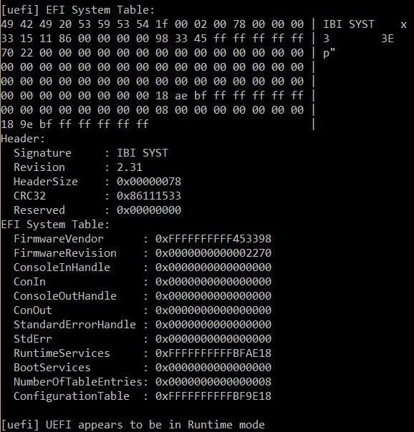
UEFI SMI Call-Outs

Slide 73
Modern EFI Firmware Also Affected
SMRAM
Trusted SMM Code and Data
UEFI RT API called by SMM code
Untrusted Address Space
Untrusted UEFI RT/OS Code and Data
UEFI services
How Many Million BIOS Would You Like To Infect by LegbaCore

Slide 74
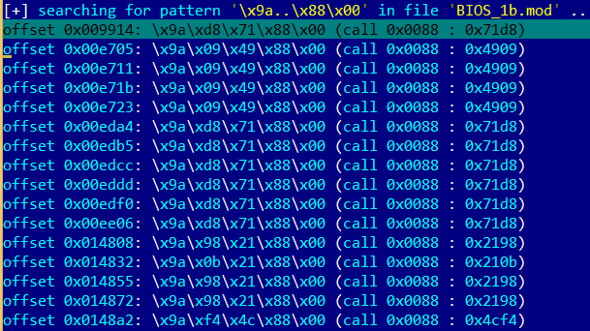
Statically analyzing SMI handlers for call-outs
Legacy SMI handlers do far calls to BIOS functions in F/E – segments (0xE0000 – 0xFFFFF physical memory) with specific code segment selectors

Slide 75
Statically analyzing SMI handlers for call-outs
Searching where EFI DXE SMM drivers reference/fetch outside of SMRAM range of addresses with IDAPython plugin by LegbaCore:
How Many Million BIOS Would You Like To Infect by LegbaCore

Slide 76
Dynamically detecting SMM call-outs
DXE SMI drivers may call Runtime, Boot or DXE services API
Find Runtime, Boot and DXE service tables containing UEFI API function pointers in memory (EFI System Table)
Patch each function with detour code chaining the original function
Enumerate and invoke all SMI handlers
If SMI handler calls-out to some UEFI API, patch will get invoked
Difficulties with this approach:
it needs enumeration of all SMI handlers (with proper interfaces)
SMI handlers may call functions not in RT/BS/DXE service tables

Slide 77
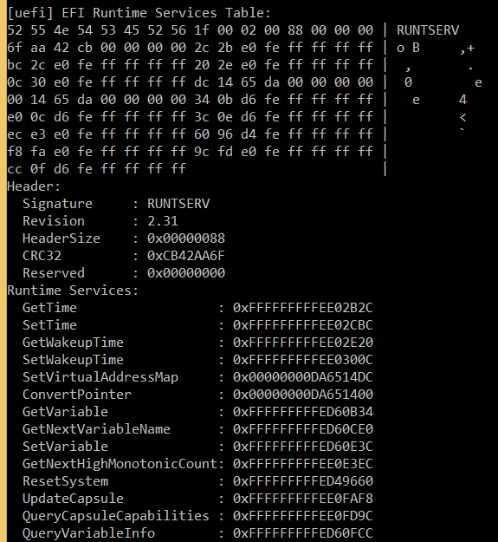
Hooking runtime UEFI services…

Slide 78
BIOS developers can easily detect call-outs
A “simple” ITP debugger script to step on branches and verify that target address of the branch is within SMRAM
Enable SMM Code Access Check HW feature on pre-production systems based on newer CPUs to weed out all “intended” code fetches outside of SMRAM from SMI drivers
NX based soft SMM Code Access Check patches by Phoenix look promising

Slide 79
Using Paging to detect SMM call-outs
NX based soft SMM Code Access Check patches by Phoenix
SMM paging/NX are enabled when CPU enters SMM
PTEs outside of SMRAM have XD=1
#PF is signaled when SMI handler attempts to fetch from any page outside of SMRAM
SMRAM
#PF handler is executed inside SMRAM
Code fetch from a page outside SMRAM causes #PFault due to XD=1
XD == 1
Page Fault

Slide 80

4.6 (2) Attacking SMI Handlers: SMI Input Pointers

Slide 81
SMI Input Pointer Vulnerabilities
When OS triggers SMI (e.g. SW SMI via I/O port 0xB2) it passes arguments to SMI handler via general purpose registers
OS may also pass an address (pointer) to a structure through which an SMI handler can read arguments & returns result
SMI handlers traditionally were not validating that such pointers are outside of SMRAM
If an exploit passes an address which is inside SMRAM, SMI handler may write onto itself on behalf of the exploit
References: A New Class of Vulnerability in SMI Handlers

Slide 82
Pointer Arguments to SMI Handlers
Phys Memory
SMI Handlers in SMRAM
OS Memory
SMI
RAX (code)
RBX (pointer)
RCX (function)
RDX
RSI
SMI handler specific structure
RDI
SMI Handler writes result to a buffer at address passed in RBX…

Slide 83
Pointer Vulnerabilities
Phys Memory
SMI Handlers in SMRAM
OS Memory
SMI
RAX (code)
RBX (pointer)
Fake structure inside SMRAM
RCX (function)
RDX
RSI
RDI
Exploit tricks SMI handler to write to an address inside SMRAM

Slide 84
What can exploit overwrite in SMRAM?
Depending on the vulnerability, caller may control address to write, the value written, or both.
Often the caller controls the address (and knows offset off of the address) but doesn’t completely control the values written to the address by the SMI handler
What can an exploit overwrite in SMRAM without crashing?
SMI entry point at SMBASE + 8000h
Internal SMI handler’s state/flags inside SMRAM
Contents of SMM state save area (registers)
Current value of SMBASE MSR is also saved in SMM state save at SMBASE + FEF8h area by CPU upon SMI
Saved value of SMBASE is restored upon executing RSM
Exploit can relocate SMRAM! Overwrite saved SMBASE to relocate SMRAM to unprotected memory location on next SMI

Slide 85
How does exploit know where to write?
Exploit needs to know location of saved SMBASE
Dump contents of SMRAM
Use another vulnerability (e.g. S3 boot script) to disable SMRAM protections and use DMA or graphics to read SMRAM
Dump SPI flash contents, extract DXE SMM binaries and find SMRAM Init there
Use similar SMI pointer read/write vulnerability
Use hardware ITP offline
Find SMM state save area for each logical CPU
SMM state save is at SMBASE + FC00h but SMBASE is different per CPU thread and per BIOS and some offset of TSEG/SMRR base
Find SMI entry point (@ SMBASE + 8000h)
Exploit can guess several locations of SMBASE (SMRR_PHYSBASE = SMBASE or SMM entry point, blind iteration through all offsets within SMRAM as potential saved SMBASE value)
Or exploit can invoke SMI handler with known values in GPRs, then find where they are saved in SMRAM

Slide 86
How does the attack work?
Phys Memory
SMI Handler
OS Memory
SMI
RAX (code)
Saved SMBASE value
SMM State Save Area
RBX (pointer)
SMI Entry Point (SMBASE + 8000h)
RCX (function)
SMBASE
SMI handler specific structure
CPU stores current value of SMBASE in SMM save state area on SMI and restores it on RSM

Slide 87
How does the attack work?
Phys Memory
SMI Handler
OS Memory
Saved SMBASE value
SMM State Save Area
SMI Entry Point (SMBASE + 8000h)
SMBASE
Fake SMI handler
Exploit prepares fake SMRAM with fake SMI handler outside of SMRAM

Slide 88
How does the attack work?
Phys Memory
OS Memory
SMI Handler
SMI
RAX (code)
Saved SMBASE value
SMM State Save Area
RBX (pointer)
SMI Entry Point (SMBASE + 8000h)
RCX (function)
SMBASE
Fake SMI handler
Exploit triggers SMI w/ RBX pointing to saved SMBASE address in SMRAM
SMI handler overwrites saved SMBASE on exploit’s behalf with address of fake SMI handler outside of SMRAM (e.g. 0 PA)

Slide 89
How does the attack work?
Phys Memory
OS Memory
SMI Handler
Saved SMBASE value
SMM State Save Area
SMI
Fake SMI handler
New SMI Entry Point
SMBASE
Exploit triggers another SMI
CPU executes fake SMI handler at new entry point outside of original protected SMRAM because SMBASE location changed

Slide 90
How does the attack work?
Phys Memory
OS Memory
SMI Handler
(SMRAM is not protected)
Original saved SMBASE value
SMM State Save Area
Fake SMI handler
New SMI Entry Point
SMBASE
Fake SMI handler disables original SMRAM protection (disables SMRR)
Then restores original SMBASE values to switch back to original SMRAM

Slide 91
How does the attack work?
Phys Memory
OS Memory
SMI Handler
(SMRAM is not protected)
SMI Entry Point (SMBASE + 8000h)
SMBASE
The SMRAM is restored but not protected by HW anymore
Any SMI handler may be installed/modified by malware

Slide 92
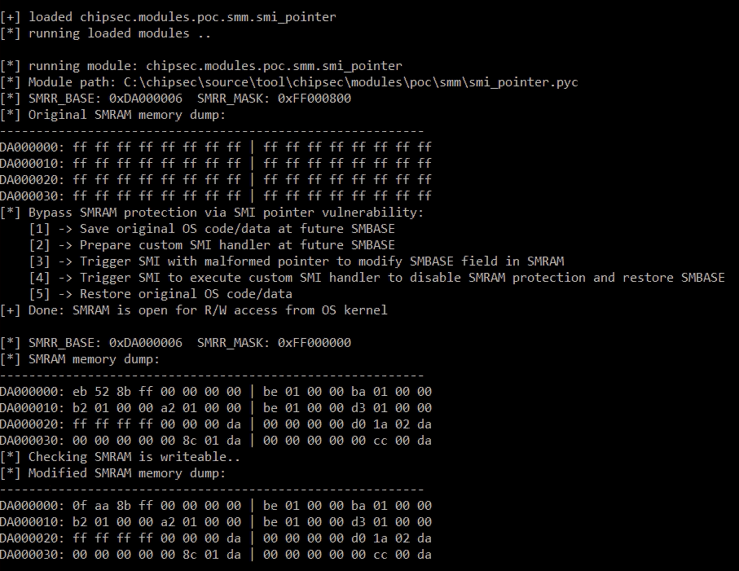

Slide 93
Input Pointers in EDKII: CommBuffer
CommBuffer is a memory buffer used as a communication protocol between OS runtime and DXE SMI handlers
Pointer to CommBuffer is stored in “UEFI” ACPI table in ACPI NVS memory accessible to OS
Contents of CommBuffer are specific to SMI handler. Variable SMI handler read UEFI variable GUID, Name and Data from CommBuffer
Vulnerability | Ref | Affected | Reported by
CommBuffer SMM Overwrite/Exposure (3 issues) | Tianocore | EDK2 | Intel ATR
TOCTOU (race condition) Issue with CommBuffer (2 issues) | Tianocore | EDK2 | Intel ATR
SMRAM Overwrite in Fault Tolerant Write SMI Handler (2 issues) | Tianocore | EDK2 | Intel ATR
SMRAM Overwrite in SmmVariableHandler (2 issues) | Tianocore | EDK2 | Intel ATR

Slide 94
Attacking CommBuffer Pointer
SecurityPkg/VariableAuthenticated/RuntimeDxe:
SmmVariableHandler (
...
SmmVariableFunctionHeader = (SMM_VARIABLE_COMMUNICATE_HEADER *)CommBuffer;
switch (SmmVariableFunctionHeader->Function) {
case SMM_VARIABLE_FUNCTION_GET_VARIABLE:
SmmVariableHeader = (SMM_VARIABLE_COMMUNICATE_ACCESS_VARIABLE *)
SmmVariableFunctionHeader->Data;
Status = VariableServiceGetVariable (
...
(UINT8 *)SmmVariableHeader->Name + SmmVariableHeader->NameSize
);
VariableServiceGetVariable (
...
OUT VOID *Data
)
...
CopyMem (Data, GetVariableDataPtr (Variable.CurrPtr), VarDataSize);
CommBuffer
SMRAM

Slide 95
Mitigating CommBuffer Attack
SMI Handlers often have multiple commands, calling a different function for each command and take command specific arguments
Note the calls to SmmIsBufferOutsideSmmValid. This checks for addresses to overlap with SMRAM range
SmiHandler() {
// check CommBuffer is outside SMRAM
if (!SmmIsBufferOutsideSmmValid(CommBuffer, Size)) {
return EFI_SUCCESS;
}
switch(command)
case 1: do_command1(CommBuffer);
case 2: do_command2(CommBuffer);
…
CommBuffer
SMRAM

Slide 96
CommBuffer TOCTOU Issues
SMI handler checks that it won’t access outside of CommBuffer
What if SMI handler reads CommBuffer memory again after the check
DMA engine (for example GFx) can modify contents of CommBuffer
InfoSize = .. + SmmVariableHeader->DataSize + SmmVariableHeader->NameSize;
if (InfoSize > *CommBufferSize - SMM_VARIABLE_COMMUNICATE_HEADER_SIZE) {
Status = VariableServiceGetVariable (
...
(UINT8 *)SmmVariableHeader->Name + SmmVariableHeader->NameSize
);
VariableServiceGetVariable (
...
OUT VOID *Data
)
...
if (*DataSize >= VarDataSize) {
CopyMem (Data, GetVariableDataPtr (Variable.CurrPtr), VarDataSize);
Time of Check
Time of Use

Slide 97
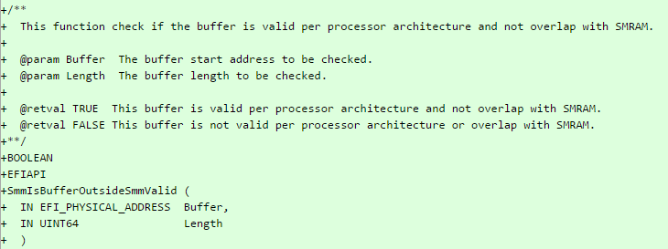
Validate input addresses before using them!
Read pointer issues are also exploitable to expose SMRAM contents
SMI handlers have to validate each address/pointer (+ offsets) they receive from OS prior to reading from or writing to it including returning status/error codes
E.g. use/implement a function which validates address + size for overlap with SMRAM similar to SmmIsBufferOutsideSmmValid in EDKII

Slide 98
Exercise 4.3
Security of SMI Handler Firmware

Slide 99
Exercise 4.4
Attacking SMI Handlers

Slide 100
4.7 Attacking UEFI Variables

Slide 101
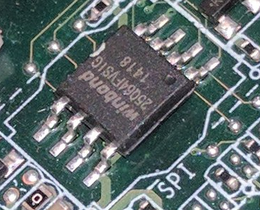
Where does firmware store its settings?
UEFI BIOS stores persistent config as ”UEFI Variables” in NVRAM part of SPI Flash chip
UEFI Variables can be Boot-time or Run-time
Run-time UEFI Variables are accessible by OS via run-time Variable API (via SMI Handler)
OS exposes UEFI Variable API to [privileged] user-mode applications
SetFirmwareEnvironmentVariable
/sys/firmware/efi/efivars/ or /sys/firmware/efi/vars

Slide 102
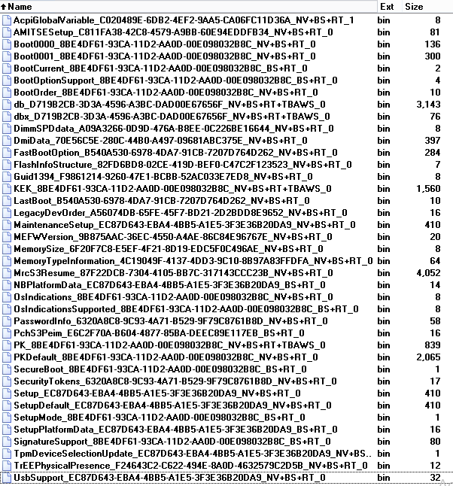
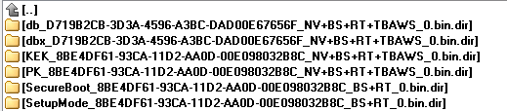
Lots of settings..
AcpiGlobalVariable
BootOrder
Secure Boot certificates
(PK, KEK, db, dbx)
Setup

Slide 103

Dangerous Contents in UEFI Variables
Secure Boot configuration settings (see our All Your Boot Are Belong To Us)
Addresses to structures/buffers which firmware reads from or writes to during boot
Policies for hardware protections & locks such as BIOS Write Protection, Flash LockDown, BIOS Interface Lock
Policies disabling security features
Values of hardware configuration registers which firmware locks down
Data which firmware really really needs to just boot
Secrets: BIOS passwords in clear
Image Source: KEEP CALM-O-MATIC

Slide 104
This cannot be good…
Overwrite early firmware code/data if (physical addresses) pointers are stored in unprotected variables
Bypass UEFI and OS Secure Boot if its configuration or keys are stored in unprotected variables
Bypass or disable hardware protections if their policies are stored in unprotected variables
Make the system unable to boot (brick) if setting essential to boot the system are stored in unprotected variables

Slide 105
Who needs a Setup variable, anyway?
VU#758382
Storing Secure Boot settings in Setup could be bad
Now user-mode malware can clobber contents of Setup UEFI variable with garbage or delete it
Malware may also clobber/delete default configuration StdDefaults
The system may never boot again
The attack has been co-discovered with researchers from LegbaCore (Corey Kallenberg, Xeno Kovah) and MITRE Corporation (Sam Cornwell, John Butterworth).
Source: Setup For Failure

Slide 106
Variable Attribute Checks in CHIPSEC
# chipsec_main.py --module common.uefi.access_uefispec
[*] running module: chipsec.modules.common.uefi.access_uefispec
[x][ =======================================================================
[x][ Module: Access Control of Variables Defined in UEFI Spec
[x][ =======================================================================
[*] Testing UEFI variables ..
[*] Variable BootOrder
[*] Variable dbx
[*] Variable ConOut
[*] Variable db
[*] Variable PK
[*] Variable BootCurrent
[*] Variable Timeout
[*] Variable KEK
[*] Variable Boot0000
[*] Variable Boot0001
[*] Variable SecureBoot
[*] Variable ConIn
..
[+] PASSED: All checked UEFI spec variables are protected according to spec

Slide 107
Exercise 4.5
Security of UEFI Variables

Slide 108
4.8 Attacking Firmware S3 Resume

Slide 109
VU# 976132 (CVE-2014-8274)
Security issues in system firmware due to handling of S3 resume boot script have been independently discovered by other security researchers
Rafal Wojtczuk of Bromium and Corey Kallenberg (@coreykal) of LegbaCore first published Attacks on UEFI Security (paper)
PoC exploit was described and developed by Dmytro Oleksiuk (@d_olex) in Exploiting UEFI boot script table vulnerability
Pedro Vilaça (@osxreverser) found related vulnerability in Mac EFI firmware (SPI Flash Configuration HW lock bit FLOCKDN is gone after resuming from S3)

Slide 110
Waking the system from S3 “sleep” state
Operating System
Apps
NORMAL BOOT
U/EFI System Firmware
S3 RESUME
BDS
DXE
UEFI core
& drivers
S3 Boot
Script Table
Restores
hardware config
Script Engine
Platform Init
Platform Init

Slide 111
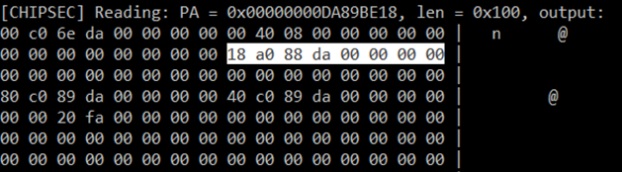
Searching for ACPI global structure…
AcpiGlobalVariable UEFI variable points to a structure in memory (ACPI_VARIABLE_SET_COMPATIBILITY)
[CHIPSEC] Reading EFI variable Name=‘AcpiGlobalVariable’..
[uefi] EFI variable AF9FFD67-EC10-488A-9DFC-6CBF5EE22C2E:AcpiGlobalVariable:
18 be 89 da

Slide 112
Searching for “S3 Boot Script”…
Pointer AcpiBootScriptTable at offset 0x18 in the structure ACPI_VARIABLE_SET_COMPATIBILITY points to the script table
typedef struct {
//
// Acpi Related variables
//
EFI_PHYSICAL_ADDRESS AcpiReservedMemoryBase;
UINT32 AcpiReservedMemorySize;
EFI_PHYSICAL_ADDRESS S3ReservedLowMemoryBase;
EFI_PHYSICAL_ADDRESS AcpiBootScriptTable;
..
} ACPI_VARIABLE_SET_COMPATIBILITY;

Slide 113
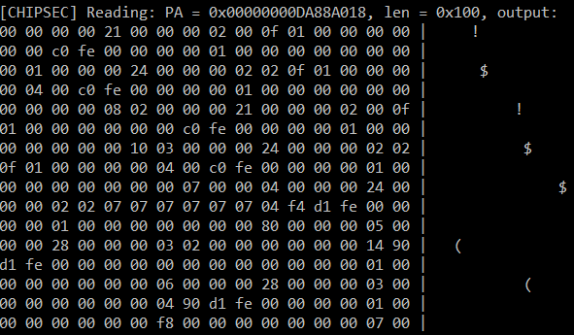
“S3 Boot Script” table in memory

Slide 114
Why “S3 Resume Boot Script”?
To speed up S3 resume, required HW configuration actions are written to an “S3 Resume Boot Script” by DXE drivers instead of running all configuration actions normally performed during boot

Slide 115
S3 Boot Script is a Sequence of Platform Dependent Opcodes
00 00 00 00 21 00 00 00 02 00 0f 01 00 00 00 00
00 00 c0 fe 00 00 00 00 01 00 00 00 00 00 00 00
00 01 00 00 00 24 00 00 00 02 02 0f 01 00 00 00
00 04 00 c0 fe 00 00 00 00 01 00 00 00 00 00 00
00 00 00 00 08 02 00 00 00 21 00 00 00 02 00 0f
01 00 00 00 00 00 00 c0 fe 00 00 00 00 01 00 00
00 00 00 00 00 10 03 00 00 00 24 00 00 00 02 02
..
01 00 00 00 00 00 00 00 f0 00 02 00 67 01 00 00
20 00 00 00 01 02 30 04 00 00 00 00 21 00 00 00
00 00 00 00 de ff ff ff 00 00 00 00 68 01 00 00
..
d3 d1 4b 4a 7e ff

Slide 116
Decoding Opcodes
[000] Entry at offset 0x0000 (length = 0x21):
Data:
02 00 0f 01 00 00 00 00 00 00 c0 fe 00 00 00 00
01 00 00 00 00 00 00 00 00
Decoded:
Opcode : S3_BOOTSCRIPT_MEM_WRITE (0x02)
Width : 0x00 (1 bytes)
Address: 0xFEC00000
Count : 0x1
Values : 0x00
..
[359] Entry at offset 0x2F2C (length = 0x20):
Data:
01 02 30 04 00 00 00 00 21 00 00 00 00 00 00 00
de ff ff ff 00 00 00 00
Decoded:
Opcode : S3_BOOTSCRIPT_IO_READ_WRITE (0x01)
Width : 0x02 (4 bytes)
Address: 0x00000430
Value : 0x00000021
Mask : 0xFFFFFFDE
# chipsec_util.py uefi s3bootscript

Slide 117
S3 Boot Script Opcodes
I/O port write (0x00)
I/O port read-modify-write (0x01)
Memory write (0x02)
Memory read-modify-write (0x03)
PCIe configuration write (0x04)
PCIe configuration read-modify-write (0x05)
SMBus execute (0x06)
Stall (0x07)
Dispatch (0x08)
Dispatch2

Slide 118
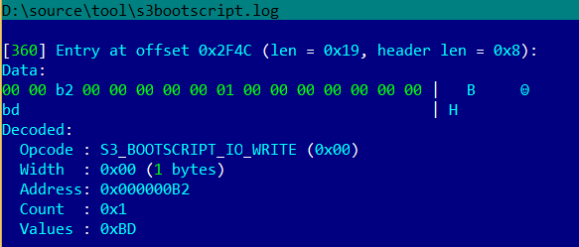
Processor I/O Port Opcodes
S3_BOOTSCRIPT_IO_WRITE/READ_WRITE opcodes in the S3 boot script write or RMW to processor I/O ports
Opcode below sends SW SMI by writing value 0xBD port 0xB2

Slide 119
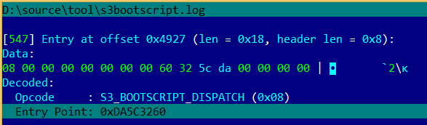
“Dispatch” Opcodes
S3_BOOTSCRIPT_DISPATCH/2 opcodes in the S3 boot script jumps to entry-point defined in the opcode

Slide 120
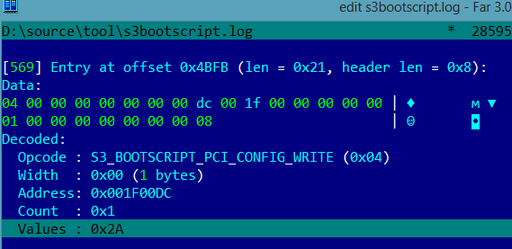
Opcode Restoring BIOS Write Protection
S3_BOOTSCRIPT_PCI_CONFIG_WRITE opcode in the S3 boot script restores BIOS hardware write-protection (value 0x2A means BIOS hardware write protection is ON)

Slide 121
Things that can go wrong
Address (pointer) to S3 boot script is stored in a runtime UEFI variable (e.g. NV+RT+BS AcpiGlobalTable)
The S3 boot script itself is stored in unprotected memory (ACPI NVS) accessible to the OS or DMA capable devices
The PEI executable parsing and interpreting the S3 boot script or any other executable needed for S3 resume is running out of unprotected memory
S3 boot script contains Dispatch (Dispatch2) opcodes with entry-points in unprotected memory
EFI firmware “forgets” to store opcodes which restore all required hardware locks and protections in S3 boot script

Slide 122
Attacking FW on resume from sleep
Exploit modifies S3 boot script table in memory
Operating System
Upon resume, firmware executes rogue S3 script which disables HW protections
Exploit
MODIFY
NORMAL BOOT
U/EFI System Firmware
S3 RESUME
BDS
DXE
UEFI core
& drivers
S3 Boot
Script Table
Restores
hardware config
Script Engine
Platform PEI
Platform PEI

Slide 123
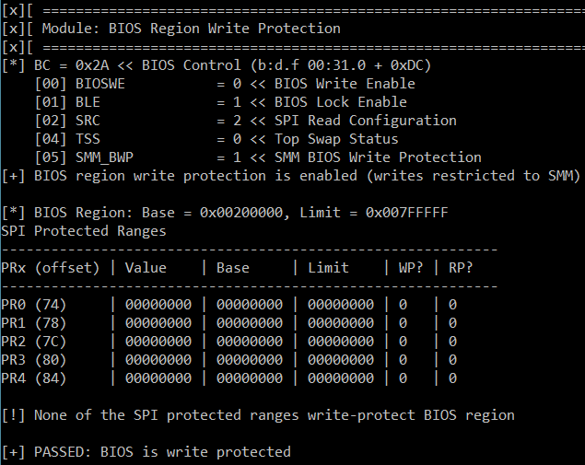
Lucky you! BIOS protection is ON
PASSED: BIOS is write protected

Slide 124
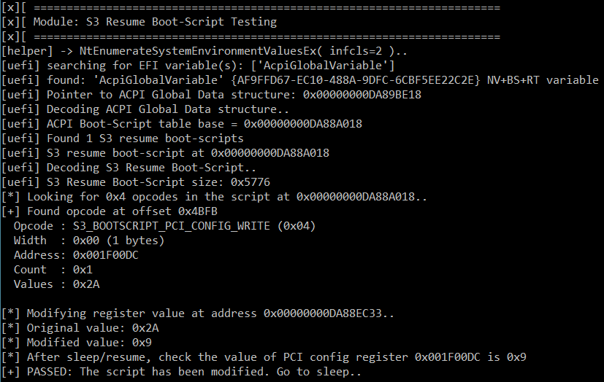
Sleep well
Found Boot Script in unprotected memory
Script Opcode restores BIOS Protection == ON
Changing it to OFF

Slide 125
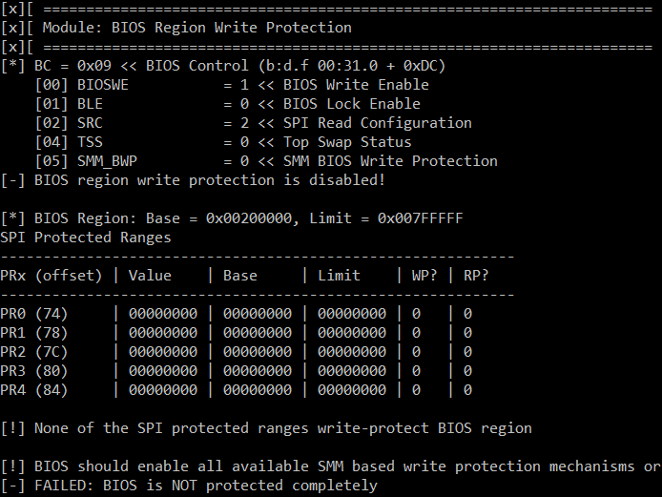
Oh wait…
FAILED: BIOS is NOT protected completely

Slide 126
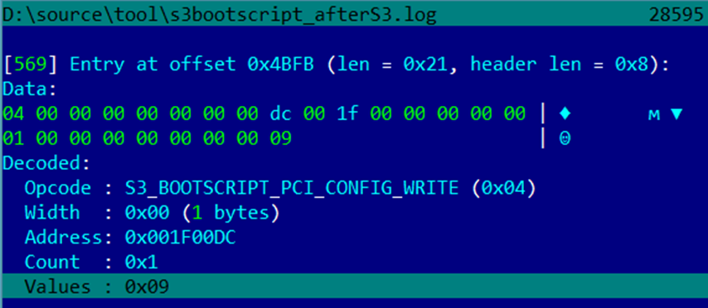
Opcode restoring BIOS Write Protection has been modified
S3_BOOTSCRIPT_PCI_CONFIG_WRITE opcode in the S3 boot script restored BIOS hardware write-protection in OFF state

Slide 127
Checking with common.uefi.s3bootscript
# chipsec_main.py –m common.uefi.s3bootscript
[x][ ==========================================
[x][ Module: S3 Resume Boot-Script Protections
[x][ ==========================================
[!] Found 1 S3 boot-script(s) in EFI variables
[*] Checking S3 boot-script at 0x00000000DA88A018
[!] S3 boot-script is not in SMRAM
[*] Reading S3 boot-script from memory..
[*] Decoding S3 boot-script opcodes..
[*] Checking entry-points of Dispatch opcodes..
[-] Found Dispatch opcode (offset 0x014E) with Entry-Point: 0x00000000DA5C3260 : UNPROTECTED
[-] Entry-points of Dispatch opcodes in S3 boot-script are not in protected memory
[-] FAILED: S3 Boot Script and entry-points of Dispatch opcodes do not appear to be protected

Slide 128
Exercise 4.6
Security of Firmware S3 Resume

Slide 129
4.9 Other Firmware Issues

Slide 130
Pre-Boot Passwords Exposed in BIOS Keyboard Buffer
BIOS and Pre-OS applications store keystrokes in legacy BIOS keyboard buffer in BIOS data area (at physical address 0x41E)
BIOS, HDD passwords, Full-Disk Encryption PINs etc.
Some BIOS’es didn’t clear keyboard buffer
References:
Bypassing Pre-Boot Authentication Passwords

Slide 131
Checking with common.bios_kbrd_buffer
# chipsec_main.py --module common.bios_kbrd_buffer
[*] running module: chipsec.modules.common.bios_kbrd_buffer
[x][ =======================================================================
[x][ Module: Pre-boot Passwords in the BIOS Keyboard Buffer
[x][ =======================================================================
[*] Keyboard buffer head pointer = 0x1A (at 0x41A), tail pointer = 0x1C (at 0x41C)
[*] Keyboard buffer contents (at 0x41E):
1e 1f 20 21 22 23 24 25 26 27 28 29 2a 2b 2c 2d | !"#$%&'()*+,-
2e 2f 30 31 32 33 34 35 36 37 38 39 3a 3b 3c 3d | ./0123456789:;<=
[+] PASSED: Keyboard buffer is filled with common fill pattern
* Better check from EFI shell as OS/pre-boot app might have cleared the keyboard buffer

Slide 132
Training materials are available on Github
https://github.com/advanced-threat-research/firmware-security-training
Yuriy Bulygin @c7zero
Alex Bazhaniuk @ABazhaniuk
Andrew Furtak @a_furtak
John Loucaides @JohnLoucaides

